Slide 1

Wine quality-Red Dataset Analysis
By
Ajay Kumar Reddy Poreddy
2247259

Slide 2

INTRODUCTION
The wine quality-red dataset comprises various chemical properties of red wine samples.
Overview
The analysis aims to understand the factors contributing to the quality of red wine
Purpose of Analysis
Understanding the attributes impacting wine quality is crucial for the wine production industry.

Slide 3
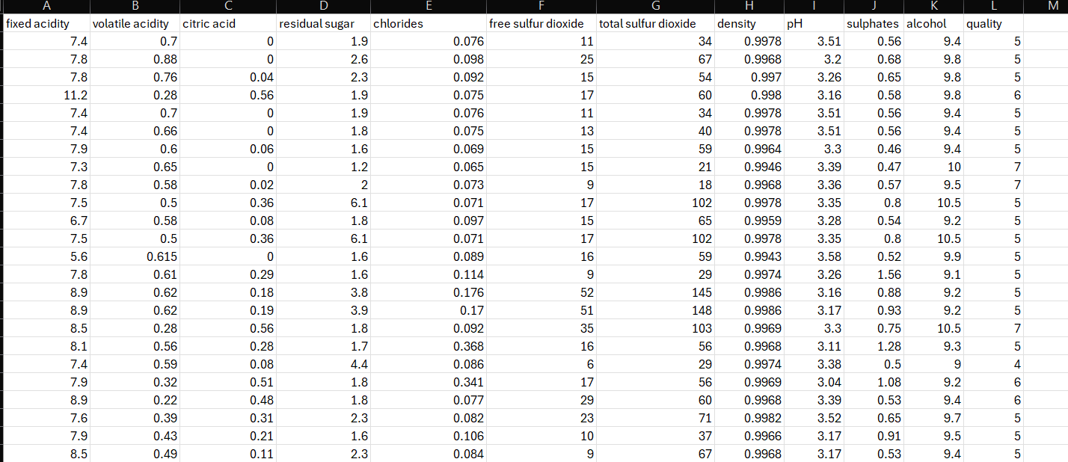

Slide 4
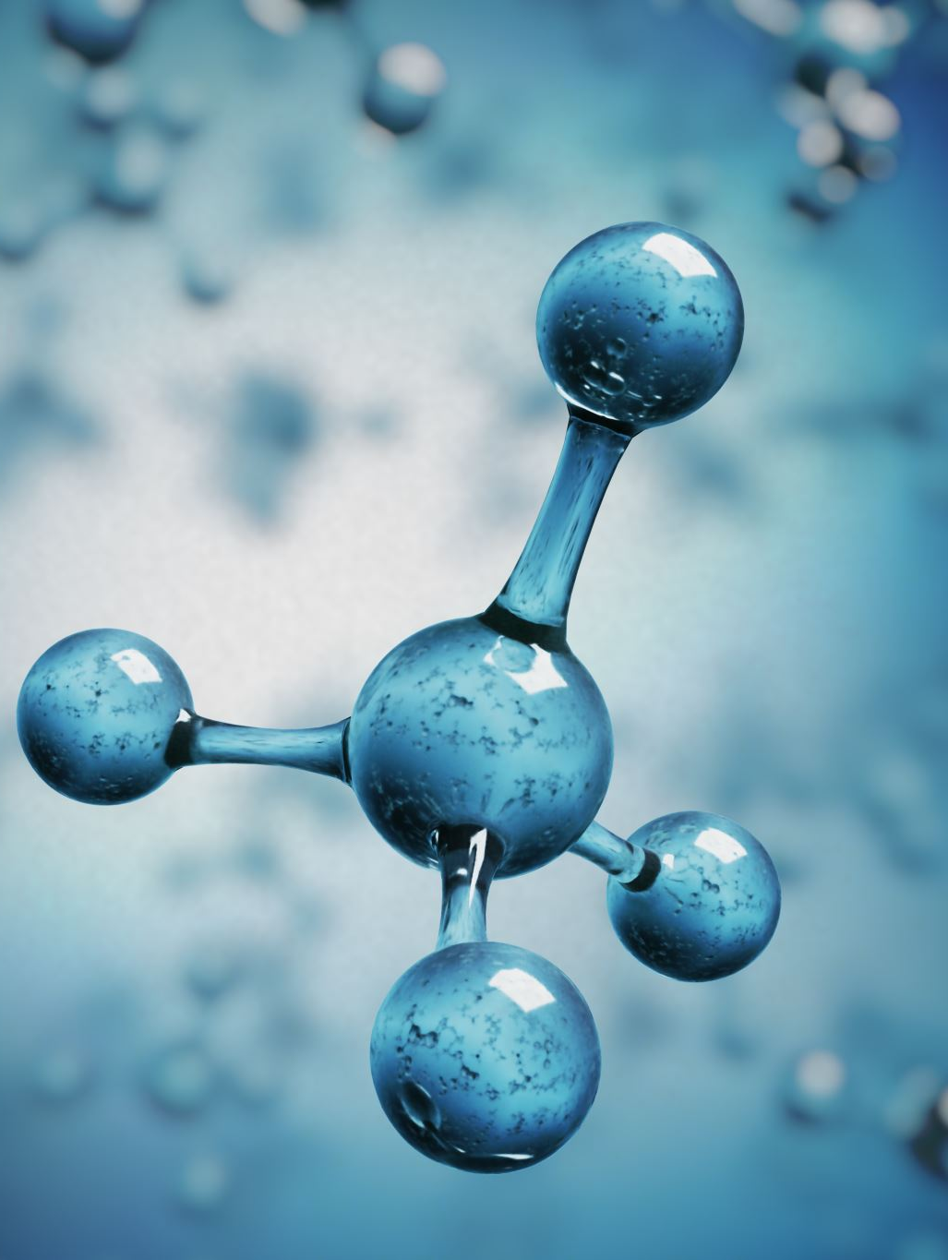
Attributes and Analysis
In the dataset the independent variables are fixed acidity , volatile acidity , citric acid , residual sugar , chlorides, free sulfur dioxide , total sulfur dioxide , density , pH , sulphates , alcohol .
The dependent variable is quality.
It consists of 1599 rows and 12 columns.
Source of the dataset:
https://www.kaggle.com/datasets/uciml/red-wine-quality-cortez-et-al-2009

Slide 5

Conclusion
Certain chemical properties significantly impact the quality of red wine, providing valuable insights for the industry.
The findings can be utilized to optimize wine production processes and ensure consistent quality.

